Slide 1
Mitochondrial dynamics in neurodegenerative diseases
10 Aprile 2019
Michelle Guarniero
Daniele Reggio
Medical Biotechnologist

Slide 2
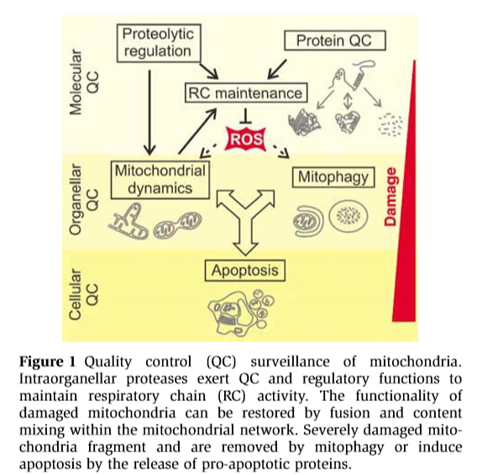
Surveillance strategies: the first layer
Molecular QC
Proteolytic
regulation
Protein QC
RC maintenance
ROS
(Adapted from Tatsuta et al. , 2008)

Slide 3
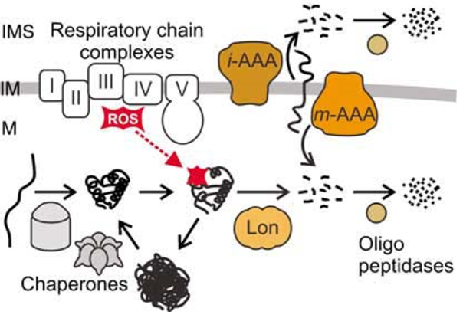
Molecular QC: different protease systems
AAA-protease
QC surveillance
RC biogenesis and integrity
QC of matrix proteins
Recognizes and removes
non-assembled and misfolded proteins selectively.
(Modified from Tatsuta et al. , 2008)

Slide 4
Molecular QC: focus on the AFG3L2 AAA-protease
AFG3L2 FUNCTIONS Stability of newly synthesized mitochondrial proteins
OM
AAA-protease
IM
AFG3L2
AFG3L2
SPG7
Homo-oligomers
Hetero-oligomers
AFG3L2 PATHOGENIC MUTATIONS
Hereditary spastic paraplegia (HSP)
Spastic ataxia (SPX55)
Spinocerebellar ataxia (SCA28)
Common Hallmarks
Loss of Mito Ribosomes
Defective Oxidative phosphorylation
Mito Fragmentation
Block of Axonal trafficking

Slide 5
Surveillance strategies: the second layer
ROS
Mitochondrial
dynamics
Mitophagy
ORGANELLAR QC
APOPTOSIS
(Adapted from Tatsuta et al. , 2008)

Slide 6
Mitochondrial dynamics: OPA1 coordinates membrane ultrastructure
Physiological condition
CYTOPLASM
OPA1
GTPase
OPA1
OMA1
+ YME1L
Cleavage
OM
TOM
S-OPA1
IMS
OMA1
S-OPA1
S-OPA1
L-OPA1
Metalloprotease
S-OPA1
A
IM
YME1L
L-OPA1
L-OPA1
i-AAA
S/L- forms Balance is crucial to determine
Membrane morphology
Mitochondrial Integrity

Slide 7
AFG3L2 dysfunction increases OMA1 activity and alters L-OPA cleavage
S-OPA1
S-OPA1
CYTOPLASM
S-OPA1
AFG3L2
GTPase
OPA1
L-OPA1
L-OPA1
OM
TOM
S-OPA1
OMA1
L-OPA1
IMS
OMA1
Metalloprotease
L-OPA1
L-OPA1
A
IM
YME1L
i-AAA
Remodelling of mitochondrial morphology
Mito fragmentation

Slide 8
Aim of the study
Elucidate the link between L-OPA1 cleavage and AFG3L2 dysfunction as a source of mitochondrial fragmentation
May other AAA-protease exert similar function on OPA1 balance?

Slide 9
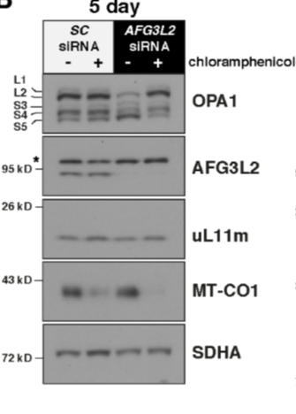
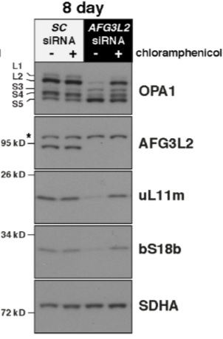
1. Elucidate the link between L-OPA1 cleavage and AFG3L2 dysfunction
SC siRNA
AFG3L2 siRNA
human fibroblasts
AFG3L2 KD
Robust L-OPA cleavage
Loss of mitochondrial ribosomal proteins
AFG3L2 KD induces L-OPA cleavage
2. Cloramphenicol treatment
rescues physiological condition
(Adapted from Richter et al. , 2019)

Slide 10
2. May other AAA-protease exert similar function on OPA1 balance?
YME1L KO
STOML2 siRNA
human fibroblasts treated and
grown at 37°C or heat shocked for 4h at 45°C
Only OMA1 but neither YME1L, nor its scaffold STOML2, are required for OPA-1 processing
YME1L and STOML2 KO did not induce translation-dependent OPA1 processing
(Adapted from Richter et al. , 2019)

Slide 11
Can all the observed effects be traced back to folding errors alone?
In a series of control cell lines, including mouse embryonic fibroblasts and HEK293 cell line, a 45°C heat shock for up to 4 hours did not induce OPA1 processing in the presence of a functional AFG3L2
(Adapted from Richter et al. , 2019)

Slide 12
Wrapping things up: Conclusions and Future Perspectives
AFG3L2 could represent:
A possible target for QC modulation
New therapeutic target for human Mito-related neuronal diseases
OPA1
L-OPA1
L-OPA1
OMA1
+ YME1L
Cleavage
OMA1
S-OPA1
S-OPA1
S-OPA1
L-OPA1
L-OPA1
L-OPA1
L-OPA1
CYTOPLASM
CYTOPLASM
GTPase
OPA1
GTPase
OPA1
OM
OM
S-OPA1
TOM
S-OPA1
TOM
IMS
IMS
L-OPA1
OMA1
OMA1
L-OPA1
IM
IM
YME1L
YME1L

Slide 13
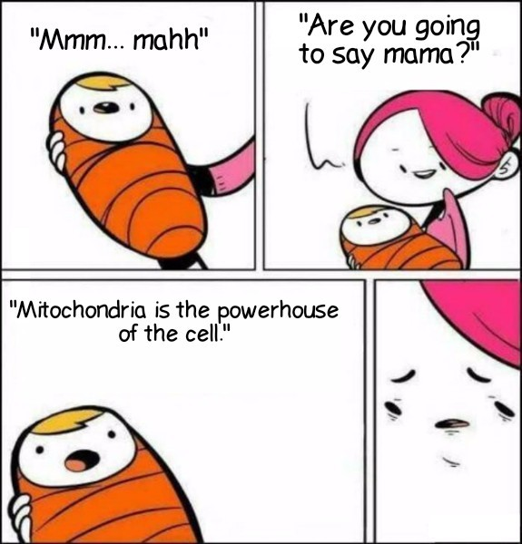
Acknowledgements
Department of Biomedical, Metabolic and Neuronal Science
University of Modena and Reggio Emilia
Michele Zoli Department director
Antonietta Vilella Research associate
Institute of Biotechnology-FinMITgroup
Helsingin Yliopisto
Brendan Battersby Research director
Uwe Richter Research associate
Kah Ying PhD Student
Valentina Casteller Master Degree Student

